Slide 1
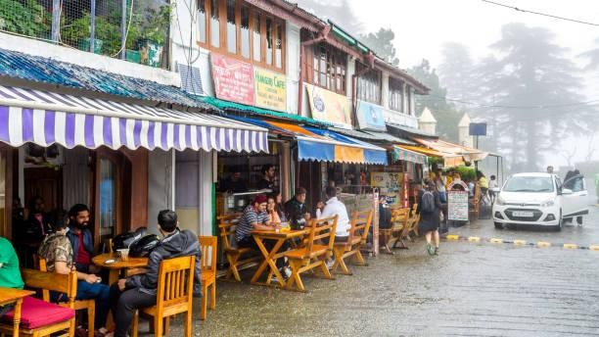
A Gastronomic Sanctuary in the Center of Mussoorie is the Mountain Bliss Café
Situated in the gorgeous hills of Mussoorie, Mountain Bliss Café is a delightful gastronomic haven that entices guests with its cozy atmosphere and mouthwatering menu. Enter a warm and welcoming area where the aromas of freshly baked pastries and freshly brewed coffee blend to create a calming atmosphere.
Customers at Mountain Bliss Café are treated to a menu that features treats from around the world in addition to regional specialties. Savor carefully made and meticulously created artisan coffees, rich pastries, and savory nibbles. The café's varied menu suits all tastes, whether you're looking for a hefty dinner, a quick snack, or a leisurely breakfast.
In addition to offering delicious food, Mountain Bliss Café offers a peaceful haven from the bustle of the city. On chilly evenings, curl up by the fireplace or enjoy the stunning views of the valley below from the outside patio. The warm ambiance of the café is enhanced by the welcoming personnel, making each visit an unforgettable one.
In the heart of cafe in mussoorie, have a genuinely unique dining experience at Mountain Bliss Café, where delicious food, wonderful people, and breathtaking surroundings combine to provide a taste of paradise.

